Slide 1

Cracking the Cloud:
How AWS Certifications can
Launch Your Career
Lucas Little
Head of Cloud & DevOps, Ippon Technologies USA
Notes:
Intro Let’s get started.

Slide 2

Lucas Little
Head of Cloud & DevOps, Ippon Technologies
AWS Subject Matter Expert, 9x Certified
UNCC Alumni, Class of 2009
linkedin.com/in/lucaslittle
Notes:
Intro / Who I Am — Quick Read
“Hey everyone — I’m Lucas Little. If you want to connect later: linkedin.com/in/lucaslittle.
I’m the Head of Cloud & DevOps at Ippon Technologies and an AWS Subject Matter Expert — meaning I help write AWS certification exams. I’ve seen exactly what employers look for when they see ‘cloud certified.’
I hold nine AWS certs, I’ve been doing cloud since before it was mainstream, and I’m a proud UNCC alum, Class of 2009. So being back here feels full circle.”
Credibility — Quick Read
“I’ve watched AWS evolve from a niche tool into the backbone of modern tech. I’ve worked across fintech, banking, and big enterprise transformations — and certifications were a major reason my career accelerated.
Being part of the AWS exam-writing process lets me see trends most people don’t: what’s in demand, what’s fading, and what actually gets people hired.”
Personal Touch — Quick Read
“I was once exactly where you are — no network, no roadmap, just trying to get into tech without messing it up.
Today I want to share the exact playbook that worked for me… and works for tons of students breaking into cloud.”
Transition — Quick Read
“But before we get into the strategy, let’s talk about the elephant in the room: the current job market.”

Slide 3
2025 Job Market Realities
"AI is driving productivity faster than the job market can absorb workers."
(World Economic Forum, 2025).
"Companies are slowing early-career hiring while they determine which tasks AI will replace."
(Harvard Business Review, 2024).
Notes:
Opening / Tone-Setter “Let’s be honest — the job market is cooked. And if you’re trying to get into tech, you feel it the most.”
WEF Quote “Big reason why? Productivity is rising faster than the job market can absorb — that’s straight from the World Economic Forum. Companies are doing more with fewer people.”
HBR Quote “And on top of that, companies are slowing early-career hiring while they figure out what AI will automate — Harvard Business Review called this out directly.”
Bring It Together “So you get this weird combo: companies need talent, but they’re hesitant to hire juniors who need training because they’re not even sure which roles will still exist.”

Slide 4
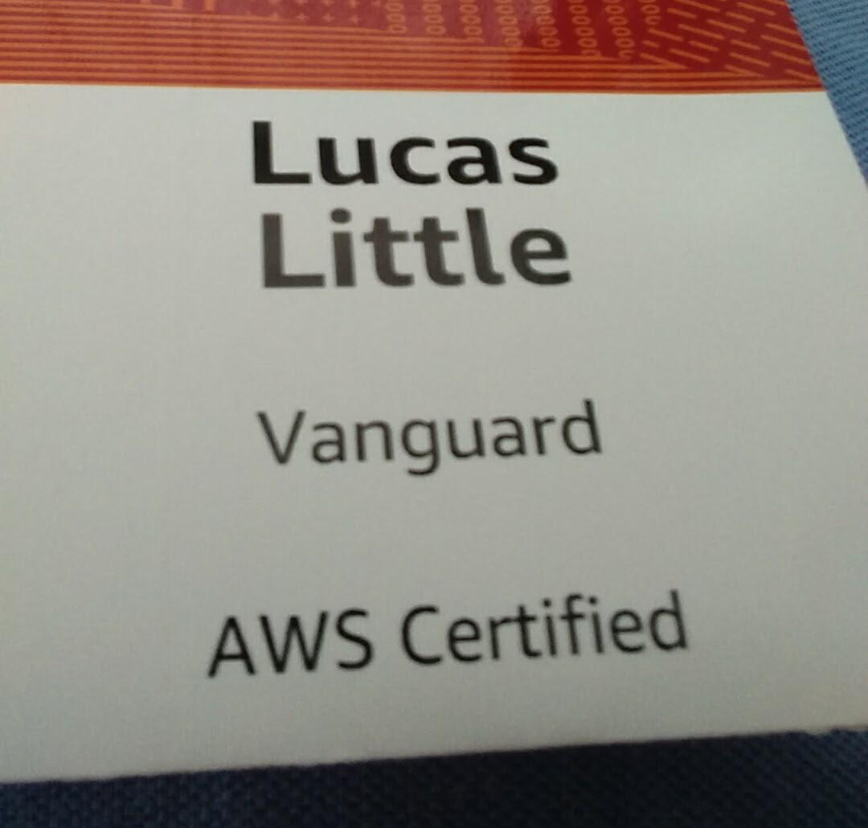
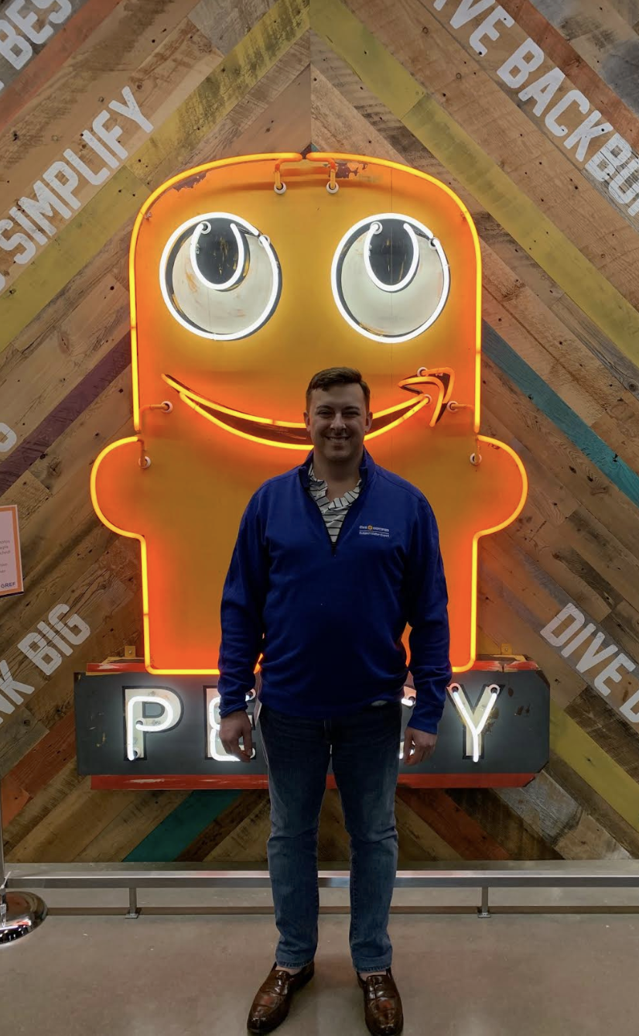
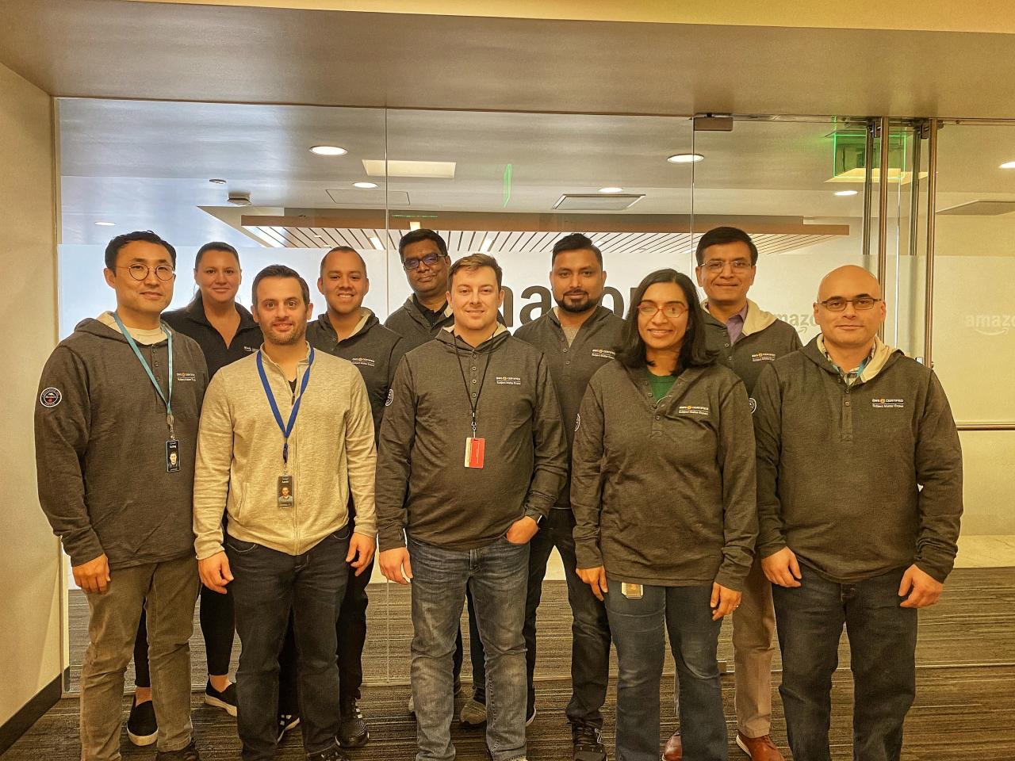
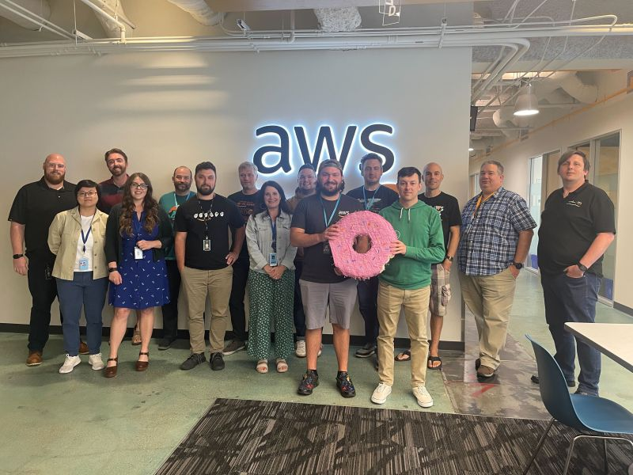
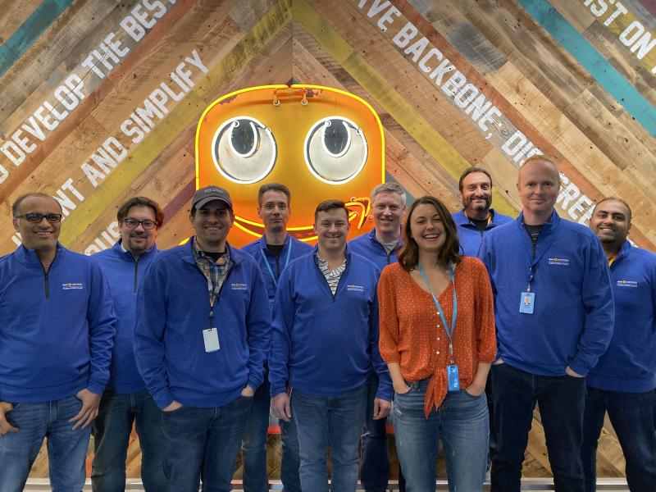
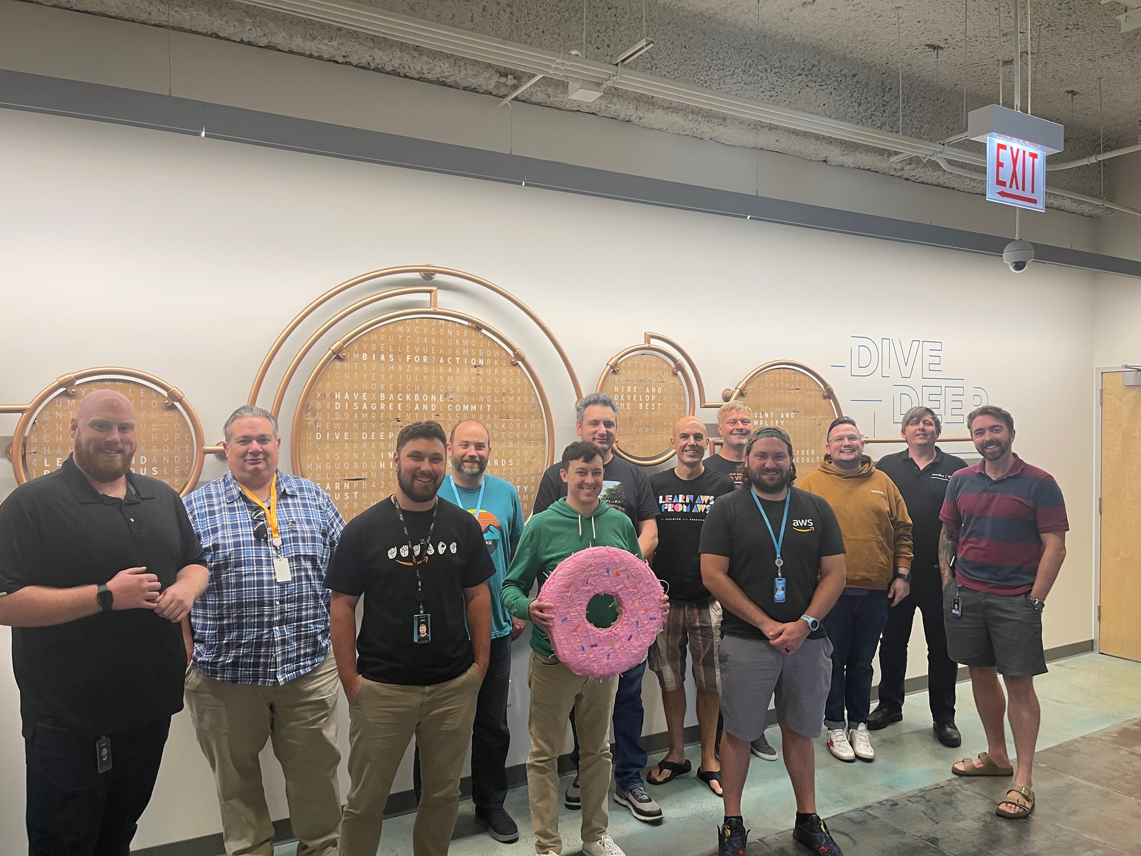
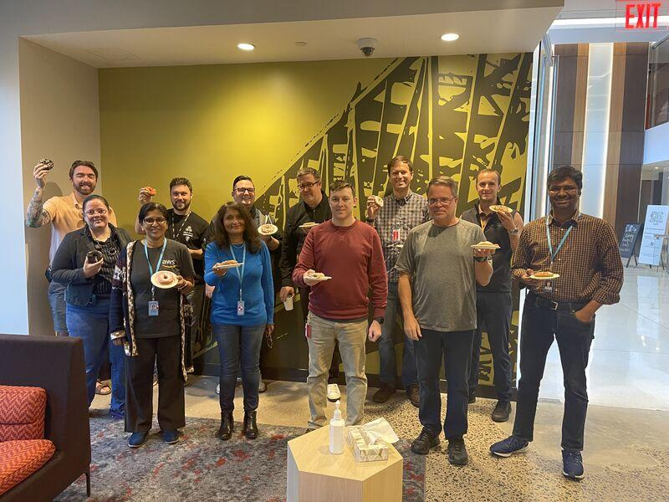

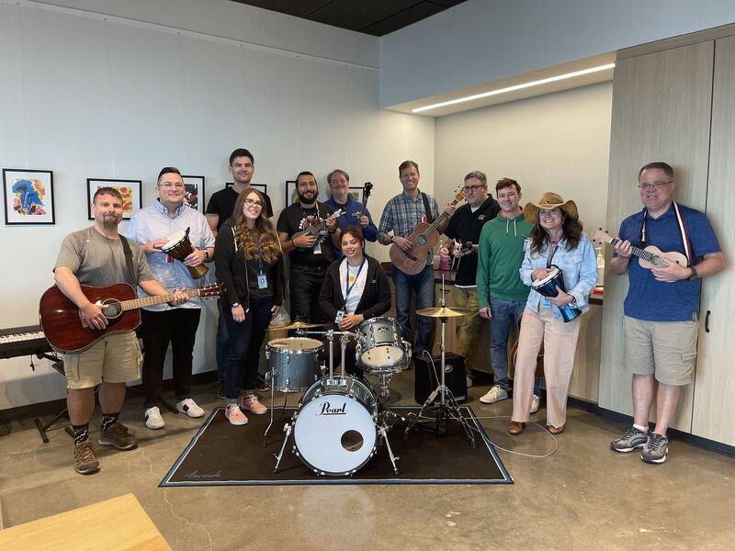
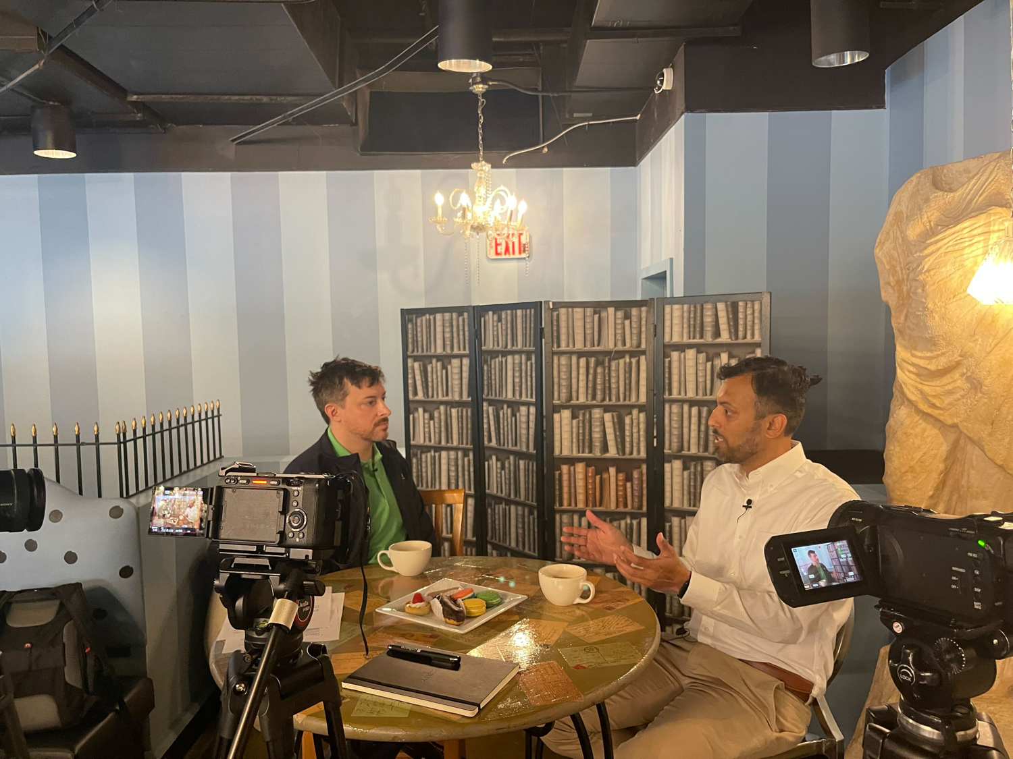
How AWS Accelerated My Career
2011—First Steps
Opened my first AWS account and started exploring.
2016—Breaking Into Cloud Industry
Joined Vanguard as a data engineer.
Recognized AWS skills were rare, so I stacked certifications to land high-visibility, career-changing projects.
2019—Building My Brand
Joined the AWS SME program to help write certification exams.
Focused on building my network and industry visibility.
Today—Paying It Forward
Helping students (like you) understand the cloud and break into the industry.
Notes:
Early Gap at Vanguard (2016) “When I joined Vanguard in 2016, almost nobody internally knew AWS. I treated that as a gap I could fill.”
Stacking Certs “I started stacking certifications fast. Skills were rare, demand was huge — and those certs opened doors to big projects and roles. That’s how I became valuable in fintech: I moved into the space where talent didn’t exist yet.”
SME Program (2019) “By 2019, that momentum got me invited into AWS’s SME program — helping write certification exams. That was massive: it leveled up my skills and plugged me into a network of AWS leaders and architects.”
Leveraging the Network “I leaned into that network hard. Those relationships became one of the biggest accelerators in my career.”
Consulting Today “Now in consulting, I use those connections to bring the right experts into client engagements — whether it’s resilience, cloud modernization, or data strategy.”

Slide 5

Poll: Have You Ever Deployed a Website Before?
https://d413meycdi03z.cloudfront.net Yes, it’s on AWS :)
Notes:
Intro “Quick pulse check — grab your phone and hit the QR code. Have you ever deployed a website before?”
Options “Choices are:
Nope, never
Yes, on AWS
Yes, on something else — Heroku, GitHub Pages, Vercel, etc.”
Set Expectations “No judgment — this is just to see where the room is. And if you deployed a cursed HTML file for class, that counts.”
Tease “We’ll come back to this poll later — it ties directly into why cloud skills are such a cheat code early in your career.”
Transition “Alright, lock in your answer… let’s keep moving.”

Slide 6
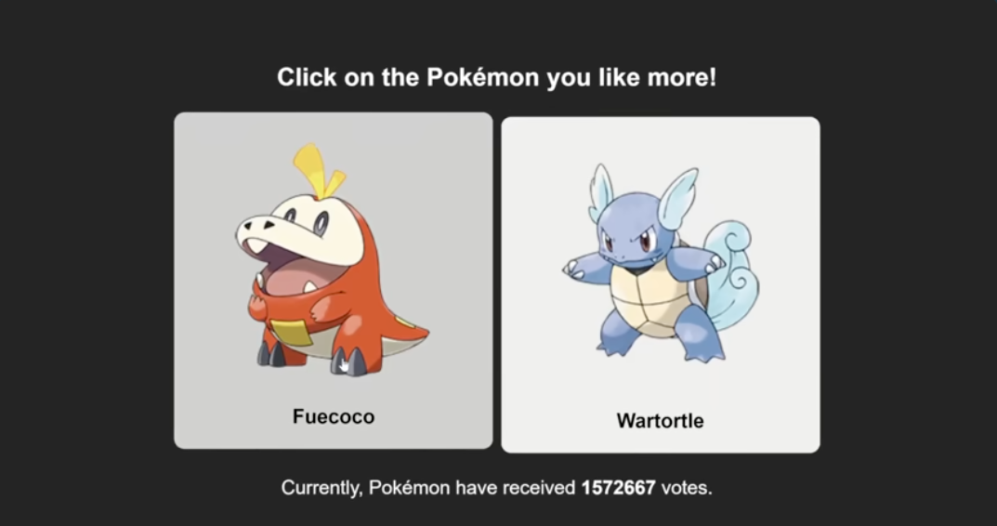
A Case Study In Scale
A YouTuber (Thomas Game Docs) posts a simple, pairwise poll: “Click on the Pokémon you like more!” The poll quickly amasses 4,000,000+ votes
Now imagine doing this with physical servers…
You would have to buy and maintain powerful enough hardware, just in case it went viral.
Figure 1 Viral Pokémon Survey Note. From "Who's a LEAST popular Pokémon? (2024)" [Video], by Thomas Game Docs, 2024, YouTube (https://www.youtube.com/watch?v=MgB7vAdajls).
Notes:
Set the Scene “Here’s a perfect real-world example of why cloud matters — and it’s personal.”
What Happened “A YouTuber, Thomas Game Docs, runs simple pairwise polls — literally: ‘Click on the Pokémon you like more.’”
The Explosion “One of these polls blew past 4 million votes fast — like startup launch or Black Friday traffic.”
Your Role “I built the backend for that survey. Thomas even shouted me out in the video — with a photo of me taken outside Atkins Library. UNCC representing in Pokémon world.”
The Core Point “And here’s the key: Thomas could never have done this on traditional servers. No data center, no racks, no $$$ for peak hardware.
Cloud made it possible — scale up to millions when viral, scale down when it’s quiet. You only pay for the peaks.”
Bring It Home “That’s the power of cloud: students, creators, tiny teams get the same muscle as giant companies.”
Transition “And that elasticity is a core idea behind AWS — so let’s dig into that.”

Slide 7
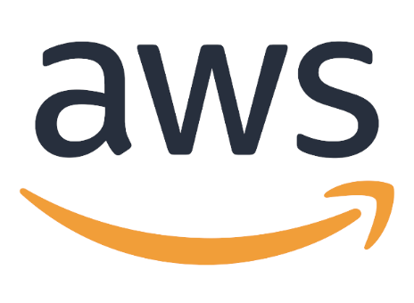

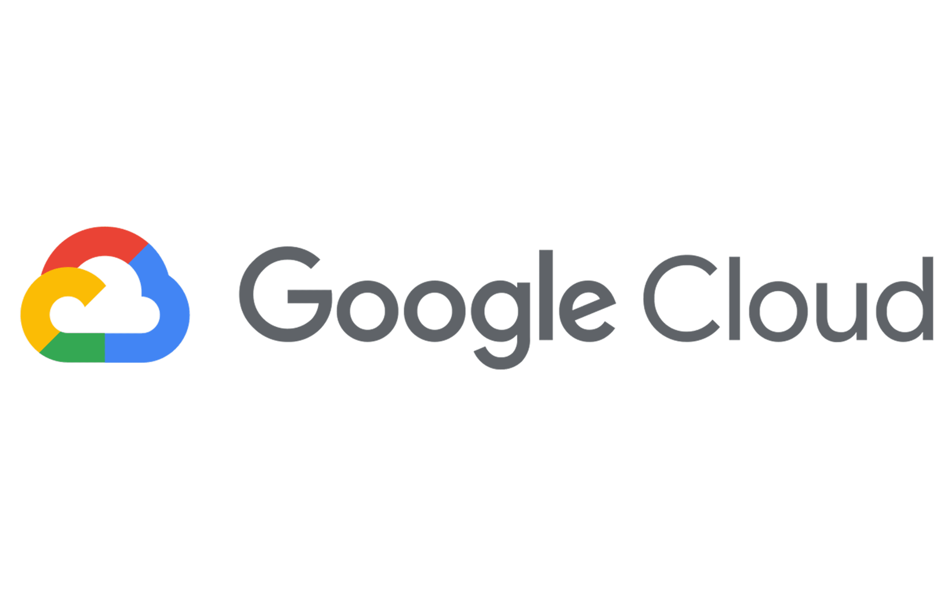
So, what actually is cloud?
Cloud is simply accessing computing power as a service, rather than owning and managing your own hardware.
Here, we’re describing the public cloud model, which is what democratized the internet. It turns computing from a capital expense (buying servers) into an operational expense (like a utility bill).
This is what allows startups—and YouTubers—to access the same global-scale tools as a bank, using a pay-as-you-go model instead of needing millions in upfront funding.
Notes:
“What Cloud Actually Is” — Quick Read Notes
Start Simple “Cloud is just computing power you access as a service instead of owning hardware.”
Relatable Analogy “It’s like electricity — you don’t build a power plant; you plug into the grid and pay for what you use. Same idea with AWS: you rent compute instead of buying servers.”
Public Cloud Model “This is public cloud — it democratized the internet. It shifted companies from big upfront purchases to simple ‘pay only for what you use’ operating costs.”
Real-World Impact “That’s why a student, a YouTuber, or a tiny startup can use the same tools as a bank. Global compute, storage, databases, ML — without needing millions in hardware.”
Tie Back to Thomas “In Thomas’s poll, cloud is what made it possible — no hardware, no data center, no predicting traffic. He paid for the surge when it happened, and it scaled back down afterward.”
Transition “Now that we know what cloud is, let’s talk about what AWS specifically does and why it leads the market.”

Slide 8
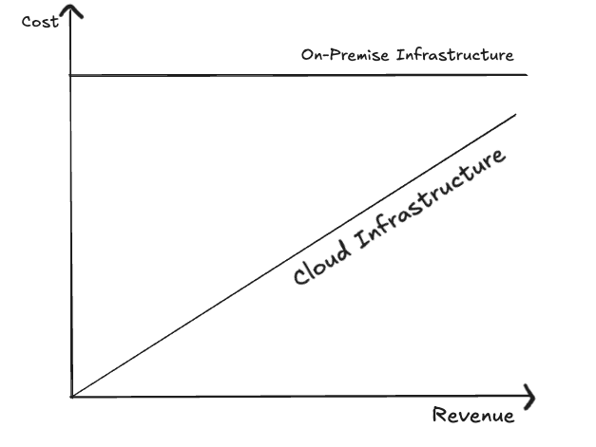
Cloud Elasticity and Capacity Planning
On-Premise Infrastructure
Guess your busiest day and buy enough servers for it
Your costs are fixed and always high
You waste money on hardware that sits idle most of the time
Cloud Infrastructure
Elastic—Scales in and out based on load
Your costs follow revenue
You only pay for what you actually use
Figure 2: Fixed vs. On-Prem Cost Structures Note. A diagram illustrating the fixed cost of on-premise infrastructure versus the variable cost of cloud infrastructure, which scales with revenue. Figure created by the author.
Notes:
On-Prem vs Cloud — Quick Read Notes
Set Up the Contrast “Let’s compare the old world to the new world — this is where cloud goes from ‘nice to have’ to ‘game changer.’”
On-Prem (The Old Way)
Guessing + Overbuying “On-prem means you guess your busiest day and buy enough hardware for that spike.”
Visual “It’s like buying a school bus just because once a year you take eight friends to the beach.”
Cost Pain “Those costs are fixed — high all the time, even when nothing’s happening.”
Waste “Most of the year that hardware sits idle, burning electricity — millions in ‘just in case’ infrastructure.”
Cloud (The New Way)
Elasticity “In the cloud, everything expands and contracts based on real traffic.”
Costs Follow Revenue “Surge of users? Costs go up while revenue goes up. Slow day? Your bill drops with it.”
Core Benefit “You only pay for what you actually use — not for hardware waiting around like it’s lonely.”
Bring It Home
“This flexibility is why creators, startups, and Fortune 500s move to AWS. It turns infrastructure from a financial gamble into a predictable, on-demand utility.”
Transition “Now that we’ve covered the ‘why,’ let’s talk about what AWS actually provides.”

Slide 9
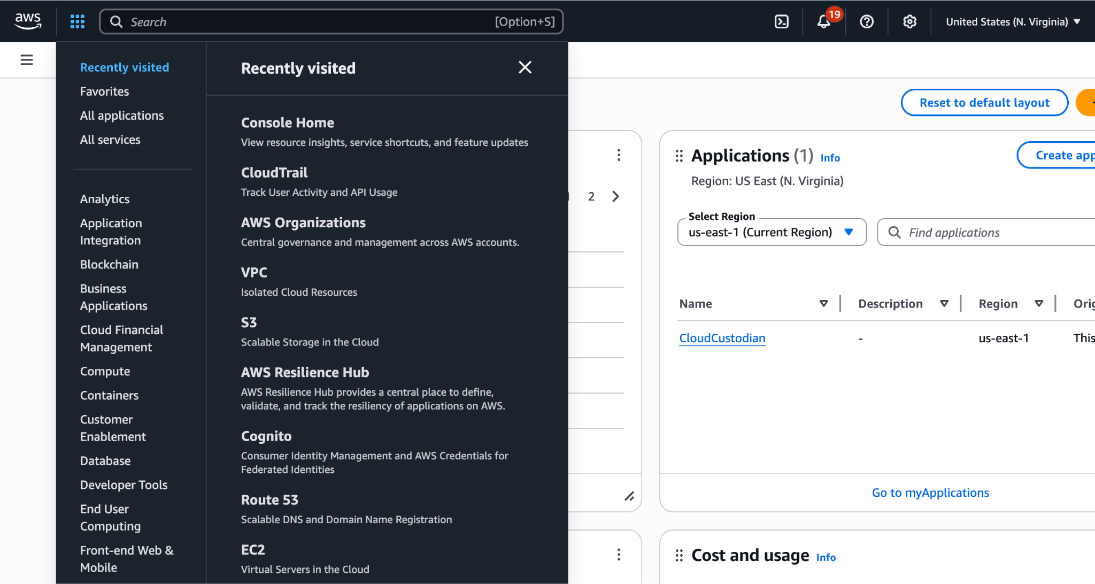
So… What is AWS?
AWS is a cloud computing platform
It is used by companies like Netflix, Amazon, NASA, Ally, Vanguard, Truist, and TikTok
200+ services—compute, storage, databases, AI/ML, networking, security, analytics—basically every building block you'd ever need
Pay only for what you use—no servers to buy, no data centers to maintain
Figure 3: The AWS Management Console Interface Note. Screenshot of the AWS console taken by the author
Notes:
Open “Now that we get cloud, let’s talk about AWS — the big one.”
What AWS Is “AWS is a cloud computing platform — basically a giant toolbox of every tech building block you could need, delivered as a service.”
Who Uses It “It’s not just startups. AWS powers Netflix, Amazon, NASA, Ally, Vanguard, Truist, TikTok — entertainment, banking, government, everyone.”
Scale of Services “Over 200 services: compute, storage, databases, networking, security, analytics, AI/ML — everything you need to build apps or scale something like that 4-million-vote Pokémon poll.”
Cost Model “You only pay for what you use. No servers to buy, no data centers to maintain, no hardware staff. Turn things on when you need them, off when you don’t.”
Bring It Home “AWS gives a single person with a laptop the same power Fortune 500 companies use.”
Transition “So if AWS is the toolbox, let’s talk about how learning to use it turns into real jobs and opportunities.”

Slide 10
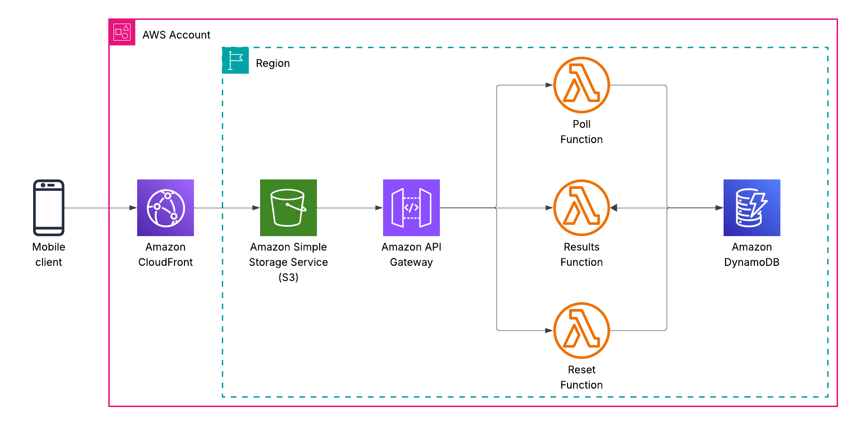
Architecture of Earlier Survey
github.com/lukelittle/cracking-the-cloud

Slide 11
Why Pursue a Career in Cloud?
According to a 2024 report, 65% of IT leaders report a "skills gap" in their cloud teams. This shows a massive, unmet demand for cloud talent. (HR Dive, 2024)
High Pay Cloud Jobs Pay More. As of late 2024, the average salary for a cloud architect is around $198,000, and a cloud engineer averages over $118,000. (Caltech, 2025)
High Impact Cloud Fuels AI. You cannot have an AI revolution without the cloud. Supporting the cloud is directly supporting the engine that AI runs on.
Just a Few of the Job Titles:
Cloud Engineer
Solutions Architect
DevOps Engineer
Cloud Security Specialist
Cloud Developer
Notes:
1. Cloud Skills Gap (HR Dive, 2024)
“65% of IT leaders say they have a cloud skills gap — two out of three companies need cloud talent they don’t have. Massive unmet demand = big opportunity.”
2. The Pay Is Real (Caltech, 2025)
“Cloud architects average ~$198k, cloud engineers ~$118k. Early-career roles often start in the $90k–$120k range. This is life-changing money.”
3. Cloud = The Engine of AI
“You can’t have AI without cloud. LLMs, training pipelines, vector databases, GPU clusters — all run on AWS, Azure, GCP. Learning cloud means learning the foundation of modern AI.”
Bring It Home
“If you’re trying to break into tech, cloud helps you stand out, get paid, and stay relevant to every major tech trend.”

Slide 12
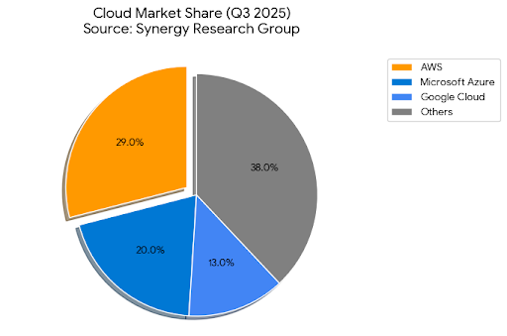
Cloud Job Market Landscape
The cloud market is dominated by three main providers, often called hyperscalers.
Amazon Web Services (AWS) is the clear and consistent market leader. This is why you see it on so many job descriptions.
The takeaway—learning any cloud is valuable, but learning AWS gives you access to the largest share of the job market.
Figure 4: Worldwide Cloud Infrastructure Market Share, Q3 2025
Note. A pie chart illustrating the worldwide cloud infrastructure market share for the third quarter of 2025. Data from "Cloud Market Growth Rate Rises Again in Q3; Biggest Ever Sequential Increase," 2025, Synergy Research Group.
Notes:
Start With Framing “So when people talk about ‘the cloud,’ they’re usually talking about the big three companies that run most of the world’s cloud infrastructure.”
Introduce the Hyperscalers “These are called hyperscalers — AWS, Azure, and Google Cloud. They’re the giants with the global data centers, the billions in hardware, the insane networking backbones — all the stuff nobody else can realistically build.”
Make the AWS Point Clearly “And here’s the key thing: AWS has been the clear, consistent market leader for over a decade. They’re the biggest, they have the most customers, and they show up on more job descriptions than anyone else.”
Why That Matters to Students “So yes — learning any cloud provider is valuable. But learning AWS gives you access to the largest share of the job market. More companies use it, more teams hire for it, and more entry-level cloud roles are built around AWS skills.”
Optional Fun Line “If cloud is a language, AWS is the one most employers speak.”
Transition “Which brings us to the part most of you are probably curious about — the certification path and how to actually break in.”

Slide 13
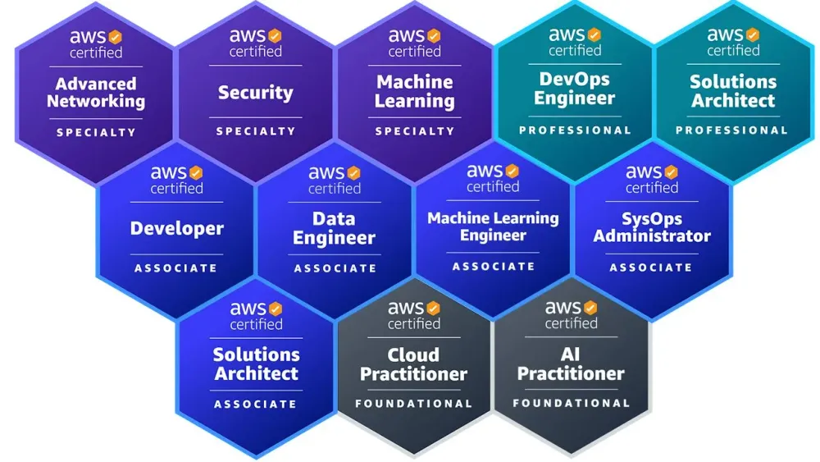
So… How Do You Get Hired?
You've seen the demand, the high pay, and the market leader.
But how do you prove you have these skills when you're a student with no "real-world" experience?
Unlike many other fields, the cloud industry has a clear and universally respected way to prove your knowledge: industry certifications.
An AWS Certification is the single most effective way to get your resume past a recruiter.
Figure 4 AWS Certification Paths Note. From AWS Certification Paths [Image], by Amazon Web Services, n.d., AWS Builder Center. (https://builder.aws.com/content/2jvnpYIWsuqS8QkxVYdy4VNpVVa/from-0-to-12-aws-certifications-my-journey-and-key-insights)
Notes:
Open With the Obvious Question “So at this point, you’ve seen the demand. You’ve seen the salaries. You’ve seen that AWS dominates the market.
But there’s still the big question every student has: How do you prove you know this stuff when you don’t have years of experience yet?”
Build the Tension “In a lot of fields, you can’t. You need internships, long projects, recommendations… and even then it’s hard to stand out.”
Introduce the Answer “But cloud is different. Cloud actually has a clear, structured, and universally respected way to prove your skills — even with zero real-world experience.”
The Big Reveal “And that’s industry certifications. Specifically, AWS Certifications.”
Hit the Value Proposition “An AWS Certification is one of the single most effective ways to get your résumé past a recruiter. It’s a trust signal. It tells employers:
‘This person understands cloud fundamentals and isn’t going to slow the team down.’”
Certs let you demonstrate skill before someone gives you your first shot.”
Transition “So let’s walk through the AWS certification pathway — what each cert means, when to take it, and how to build a portfolio that actually gets you hired.”

Slide 14
What Are AWS Certifications Anyway?
An AWS Certification is a credential you earn by passing a standardized test.
The exams are created by experienced professionals who define the exact, practical skills needed for a real-world cloud job.
This is why employers value them. A certification proves you've been tested against a rigorous, industry-vetted standard of what the job actually requires.
It shows you have a verified, practical foundation for that role.
Notes:
Open With a Clear Definition “So let’s talk about what an AWS Certification actually is. It’s a professional credential you earn by passing a standardized exam. Pretty straightforward — but the important part is how these exams are built.”
Explain the Credibility “These tests aren’t written by random people. They’re created by experienced cloud architects, engineers, and SMEs — people who do this work every day. They define the exact, practical skills someone needs to succeed in a real cloud job.”
Why Employers Care “And this right here is why employers value AWS certs so much. When you pass one, it proves you’ve been tested against a rigorous, industry-vetted standard — not just theory, not just memorization, but the real stuff practitioners use.”
Sell the Practical Foundation “So a certification tells a hiring manager:
‘This person has a verified, practical foundation. They understand how to navigate AWS in a real environment.’
It lowers their risk. It boosts your credibility. And it gives you a way to show competence before you have a full résumé.”
Transition “Now let’s walk through the certification pathway so you know exactly where to start and what each level actually means.”

Slide 15
Understanding The Certification Levels
Foundational (e.g., Cloud Practitioner)
Answers the question: "What is the cloud?"
This level measures your grasp of the core concepts, key services, and business value. It's the "vocabulary" exam that teaches you how to talk the talk.
Associate (e.g., Solutions Architect - Associate)
Answers the question: "How do I build with it?"
This is the first true technical exam. It measures your hands-on skills in designing and building secure, scalable, and cost-effective solutions.
Professional & Specialty
Answers the question: "How do I master it?"
This level measures deep, expert-level skills in either a broad (professional) or a very specific (specialty, like security or networking) domain.
Notes:
Set the Frame “Alright, here’s the roadmap. AWS certifications are structured in levels — and each level answers a different question about your cloud skills.”
1. Foundational — Cloud Practitioner
“What is the cloud?” “The Foundational level is the vocabulary exam. It makes sure you understand the core ideas: what the cloud is, why companies use it, what the main AWS services are, and how cloud drives business value.”
Why it matters “This is perfect if you’re new to cloud. It teaches you to ‘talk the talk’ — which is honestly half the battle in interviews.”
2. Associate — Solutions Architect Associate
“How do I build with it?” “This is the first real technical cert. It tests your ability to design secure, scalable, cost-effective solutions on AWS.”
Why it matters “This one proves you can actually use AWS — not just talk about it. For early-career roles, this is the credential that really moves the needle.”
3. Professional & Specialty
“How do I master it?” “At this point, you're demonstrating expert-level skills. Professional certs cover broad, complex architecture across entire systems. Specialty certs dive deep into focused areas like security, networking, databases, or machine learning.”
Why it matters “These are the badges that say:
‘I don’t just know AWS — I can own a domain.’”
Bring It Home
“The beauty here is that the path is flexible. You can start at the foundational level and move up… or skip straight to associate if you’re ready.”
Transition “Now let me show you how to think about which one to start with — and the strategy I recommend for students breaking into cloud.”

Slide 16

How To Choose Your Path
For 99% of students, your path starts here.
AWS Certified Cloud Practitioner (CLF-C02) — It’s designed for everyone, including technical, business, and marketing students.
This is the most important first step. It teaches you the language of the cloud—the core services, key concepts, and business value.
You learn "what" the services are before you learn "how" to build with them.
https://aws.amazon.com/certification/certified-cloud-practitioner/
Notes:
Slide — “Where Students Should Start: Cloud Practitioner” Speaker Notes
Open With Confidence “For 99% of students, your path starts right here. The very first certification you should go after is the AWS Certified Cloud Practitioner, the CLF-C02.”
Who It’s For “And the cool part? It’s designed for everyone. Technical majors, business majors, marketing students — anyone who wants to understand how modern tech actually works.”
Why It’s the Essential First Step “This cert teaches you the language of the cloud. Before you ever architect something or deploy anything, you need to understand the basics: What are the core services? What problems do they solve? Why do companies use AWS in the first place?”
Make It Relatable “You’re learning the ‘what’ before the ‘how.’ And once you speak the vocabulary of cloud — EC2, S3, Lambda, IAM — suddenly every other cert, every job description, every interview makes way more sense.”
Emphasize Importance “This is the most important first step. It builds a foundation you’ll use for the rest of your career, no matter what technical path you choose.”
Transition “Once you’ve got this down, then you’re ready for the more technical associate-level certifications that prove you can actually build things.”

Slide 17
How To Prepare
1. Read the Exam Guide
Why? It's the "blueprint" from AWS. It tells you exactly what's on the test.
2. Take a Video Course
Why? This is your main textbook. It teaches you all the topics from the blueprint.
(e.g., Stephane Maarek, Adrian Cantrill, AWS Skill Builder)
3. Get Hands-On (The Most Important Step)
Why? This is how you actually learn and prove your skill.
How? Use the AWS Free Tier to build a simple project.
4. Use Practice Exams
Why? AWS questions are tricky. This teaches you how to take the test.
(e.g., Tutorials Dojo, Whizlabs)
Notes:
Slide — “How to Study for an AWS Certification” Speaker Notes
Set the Frame “Alright — here’s the part everyone cares about: How do you actually study for these exams in a way that works? This is the exact playbook I recommend to every student.”
1. Read the Exam Guide
“Step one: always start by reading the exam guide.
Why? Because it’s literally the blueprint from AWS. They tell you exactly what topics are on the test — no guesswork, no surprises. Think of it as the syllabus for the certification.”
2. Take a Video Course
“Next, take a video course. This is your main textbook.
Why? Because it walks you through every topic from the exam guide in a structured, digestible way.
A few great options:
Stephane Maarek
Adrian Cantrill
AWS Skill Builder
All of these are solid, and you really only need one.”
3. Get Hands-On (The Most Important Step)
“This is the part most people skip — and it’s the most important step.
Why? Because you only really learn AWS by actually using it. Hands-on work takes everything from abstract to ‘oh, I get it now.’”
“How? Use the AWS Free Tier. Spin up an EC2 instance, put a file in S3, build a tiny serverless app — anything. Even the simplest project will help the concepts lock into place.”
4. Use Practice Exams
“And finally: practice exams.
Why? Because AWS questions are tricky. They’re long, full of details, and focused on scenarios. Practice tests teach you how to read them, how to eliminate wrong answers, and how to manage your time.
Good providers include:
Tutorials Dojo
Whizlabs.”
Bring It Home
“If you follow this exact sequence — blueprint → course → hands-on → practice tests — you will pass. It’s predictable. It works. And it builds both knowledge and confidence.”
Transition “Now let’s talk about the biggest advantage you have as students — the free training and resources you can start using today.”

Slide 18
How Certifications Get You Hired
A certification is a powerful tool that signals clear value to employers.
Passes the "Keyword" Filter: Gets your resume past automated scanners (ATS) looking for "AWS" or "Cloud."
Acts as a Credibility Stamp: Proves you are disciplined and serious, not just "curious."
Shows You "Speak the Language": Confirms you know the core services (like EC2 and S3) and can contribute from day one.
How It Opens Doors:
For Internships: Makes you a top-tier applicant who requires less training.
For Cloud Engineering: It's your "foot in the door," securing the technical interview.
For Consulting: Provides the external validation a company needs to put you in front of clients.
Notes:
Slide — “Why Certifications Actually Open Doors” Speaker Notes
Start With the Big Idea “A certification isn’t just a badge. It’s a signal — a really powerful one — that tells employers exactly what they need to know about you.”
Passes the ‘Keyword Filter’
“First, certifications get your résumé past the machines. Most companies use ATS systems that scan for keywords like ‘AWS,’ ‘Cloud,’ or specific cert names.
If your résumé has an AWS certification on it? You automatically get pushed into the ‘potential candidate’ pile instead of the trash pile.”
Acts as a Credibility Stamp
“Second, it’s a credibility stamp. It says you’re disciplined, serious, and willing to put in the work. You’re not just ‘cloud-curious’ — you took an exam created by industry experts and passed it.”
Shows You “Speak the Language”
“Third, it proves you can actually speak cloud. You know what EC2 is. You know what S3 is. You understand IAM, regions, availability zones, and the vocabulary teams use every day. That means you can contribute on day one without slowing anyone down.”
How It Opens Doors
For Internships
“Internship managers want students who can get up to speed quickly. A cert puts you in the top tier instantly because they know you’ll need less hand-holding.”
For Cloud Engineering Roles
“This is your foot in the door. The cert gets you the interview — then your projects and hands-on experience close the deal.”
For Consulting
“And for consulting — which is what I do — certifications are huge. They’re external validation we can show clients to prove our people know their stuff. It’s literally part of how we win business.”
Bring It Home
“So when you get a cert, you’re not just learning cloud. You’re reducing employer risk. And when you reduce risk, you get hired.”
Transition “Now let’s talk about the free and low-cost resources you all can start using immediately to begin this journey.”

Slide 19
Certifications Get You the Interview...
...But Hands-On Skill Gets You the Job
A certification proves you have the knowledge. A personal project proves you have the skill.
So… how do you stand out from everyone else who also has the certification?
Notes:
A certification proves you have the knowledge. A personal project proves you have the skill.
So… how do you stand out from everyone else who also has the certification?

Slide 20
Strategies to Differentiate Early In Your Career
1. Gain Practical Experience
You don't need a job. Use the AWS Free Tier to build a project. This is your proof.
2. Build Your Personal Brand
Talk about what you built. Write a simple LinkedIn post or blog article about your project.
3. Network Intentionally
Go where the community is. Join hackathons or AWS User Groups (Meetup.com) to meet mentors.
4. Apply for the Job
Apply even if you don't meet 100% of the requirements. Use your cert and project as your experience.
Notes:
Open With Purpose “Okay — certs are great, but I want to give you the actual playbook I’ve seen work over and over for students breaking into cloud.”
1. Gain Practical Experience
“You don’t need a job to get experience. Seriously — the AWS Free Tier exists so you can build something on your own.
Make a tiny website. Build a serverless API. Deploy a database. Anything.
That project becomes your proof. It’s your ‘experience’ even if no one paid you to do it.”
2. Build Your Personal Brand
“Next — talk about what you built. Post it on LinkedIn, write a short article, make a one-minute video walking through your project.
Why does this matter? Because when a recruiter googles you — and they will — they’ll see someone who takes initiative and actually builds things.”
3. Network Intentionally
“Go where the cloud community hangs out. Join AWS User Groups on Meetup.com, go to hackathons, join Discord servers, attend local tech events.
Showing up is half of networking. And the people you meet there become mentors, referrals, and future teammates.”
4. Apply for the Job
“And finally: apply. Do it even if you don’t check every box. Early-career job descriptions are basically wish lists.
Your certification + your project = your experience. That’s enough to get interviews — and interviews turn into offers.”
Bring It Home
“This is the formula. Build something → Show it publicly → Meet people → Apply anyway. You repeat this loop, and something lands.”

Slide 21
Your First Project
A certification proves your knowledge; a project proves your skill.
How to Start:
Use the AWS Free Tier. You don't need a job to get experience.
In the interview: SHOW what you built, don't just TELL what you know.
Good:
Host a static resume website on CloudFront/S3.
Launch a simple EC2 web server.
Better:
Build a serverless "contact me" form (Lambda + API Gateway).
Create a simple backend for a mobile app (AppSync or Lambda).
Best:
Build a simple, useful tool and put it on a marketplace.
Even $1 in recurring revenue (MRR) is the ultimate proof of skill and initiative.
Notes:
Slide — “Projects: Your #1 Differentiator” Speaker Notes
Open With the Key Insight “This right here is the number one differentiator. Certifications prove you know cloud… but projects prove you can actually do cloud.”
Make It Real for Students “You can have every badge in the world, but when you show up to an interview and say, ‘Here’s something I built. Here’s how it works. Here’s why I designed it this way,’ that puts you miles ahead of other applicants.”
How to Start
“And here’s the best part: You don’t need a job to get experience. AWS literally gives you a Free Tier so you can build things on your own time.”
“Spin up an EC2 instance. Deploy a static website in S3. Build a Lambda function. Make a tiny API — anything.”
The bar is not high. The impact is huge.
In the Interview
“And when you get to the interview? Don’t just tell them what you know. Show them what you built.”
Open your laptop. Walk them through your architecture. Explain why you chose certain services. Even a simple project can make you look seasoned and confident.”

Slide 22
Developing Your Personal Brand
A project you build but never talk about doesn't exist to an employer.
How to Build Your Brand
Optimize Your LinkedIn: This is your professional storefront.
Add your AWS Certification badge to the "Licenses & Certifications" section.
Create a "Projects" section and link to what you built (even if it's simple).
Incorporate this in addition to Leetcode/Kaggle, not as a substitute
Write About Your Work:
Write a simple blog post or LinkedIn article titled, "How I Built a Serverless Website on AWS."
Share what you learned: What was hard? What broke? How did you fix it? This shows initiative, communication skills, and passion.
An employer sees not just a student, but a passionate builder who takes initiative.
Notes:
Open With the Core Truth “A project you build but never talk about… doesn’t exist to an employer. If they can’t see it, it might as well not have happened.”
Set the Tone “And this is where personal branding comes in — not in a cringey influencer way, but in a very practical, ‘show your work’ way.”
How to Build Your Brand
Optimize Your LinkedIn
“Think of LinkedIn as your professional storefront. If a recruiter looks you up — and they will — this is the first impression.”
“Add your AWS Certification badge to the Licenses & Certifications section. Make a Projects section and link to what you built — even if it’s small. A simple serverless app or S3 website is enough.”
Important point: “This isn’t instead of Leetcode or Kaggle — it’s in addition to them. Your cloud project shows applied skills, not just problem solving.”
Write About Your Work
“Next: talk about what you built. Write a short LinkedIn post or article — nothing fancy — something like: ‘How I Built a Serverless Website on AWS.’”
“Share the journey: What was hard? What broke? How did you fix it? That shows initiative, problem solving, and communication — all the things employers care about.”
Why This Works
“When an employer sees your LinkedIn and they see:
a certification,
a real project, and
a thoughtful write-up…
they don’t just see a student anymore. They see a passionate builder who takes initiative. Someone who’d show up on the first day ready to contribute.”

Slide 23
Networking
Your network is how you find the "hidden" job market—the roles that are never posted online.
How to Network (Without Being Awkward)
Go Where the Community Is:
Join a hackathon (this is #1 and #3 in one—you build a project and meet people).
Use a service like Meetup.com to find and attend local or virtual AWS User Group meetups. You don't have to talk; just go and listen.
Join online communities (like Discord, Reddit, or LinkedIn Groups) focused on AWS.
The Right Way to "Ask":
Don't say, "Hi, can you get me a job?"
Do say: "Hi, I'm a student who just got my Cloud Practitioner cert. I built this project. Am I on the right track?"
The Goal: You are looking for mentors, not just jobs. Mentors will lead you to jobs.
Notes:
Slide — “How to Network (Without Feeling Awkward)” Speaker Notes
Open With the Core Truth “Alright, let’s talk about networking — the thing everyone hates but everyone needs. Your network is how you find the hidden job market. These are the roles that never make it to LinkedIn or Indeed because they get filled through referrals.”
How to Network (Without Being Awkward)
1. Go Where the Community Is
“You don’t need to be charismatic, and you don’t need to be an extrovert — you just need to show up.”
Hackathons “Hackathons are the best of both worlds: You build a project and you meet people. This is #1 and #3 from earlier combined.”
AWS User Groups “Use Meetup.com to find local or virtual AWS User Group meetups. And you don’t have to talk — just sit, listen, learn, and absorb.”
Online Communities “Join Discord servers, Reddit communities, or LinkedIn groups focused on AWS. These are full of engineers, hiring managers, and mentors.”
The Right Way to Ask
Start With Value, Not Requests “The biggest mistake students make is messaging someone with: ‘Hi, can you get me a job?’ That’s the fastest way to get ignored.”
Instead, say something like: ‘Hi, I’m a student who just earned my Cloud Practitioner cert. I built this project using the AWS Free Tier. Am I on the right track?’
“That’s a completely different vibe. It shows initiative, effort, and respect for their time.”
The Real Goal
“You’re not hunting for jobs — you’re looking for mentors. Because mentors lead you to jobs. Mentors recommend you. Mentors tell you about opportunities before they’re posted. Mentors help you level up way faster.”
Bring It Home
“Networking isn’t about being outgoing — it’s about being visible, being curious, and showing progress.”

Slide 24
Landing Your First Job
Your certification and your project make you a top-tier candidate. This is how you get your first "yes."
Apply (Even for the "Scary" Jobs)
Don't reject yourself—let them say no. Job descriptions are a wish list, not a checklist.
Let Your Project Portfolio Be Your Experience
This is the proof that replaces the "X years of experience" requirement.
Remember the 1-2 Punch
The cert gets you the interview.
The project gets you the job.
Notes:
Open With the Empowering Truth “Here’s the good news: Your certification plus your project already puts you in the top tier of early-career candidates. This is how you get your first real ‘yes.’”
Apply — Even for the “Scary” Jobs
Normalize the fear “A lot of students see a job description and think, ‘Oh no, I don’t check every box, I shouldn’t apply.’ Don’t do that.”
Reframe it “Job descriptions are wish lists, not checklists. Companies describe the perfect unicorn… and then they hire a real human.”
Punchline “Don’t reject yourself — let them say no.”
Let Your Project Portfolio Be Your Experience
“Most entry-level cloud roles ask for ‘1–3 years of experience.’ Your project is that experience.
When you show a hiring manager something you built — an S3 website, a serverless API, a tiny architecture diagram — suddenly the ‘years of experience’ requirement becomes flexible.”
“This is the proof that replaces the bullet points you don’t have yet.”
Remember the 1–2 Punch
“This is the formula you want burned into your brain:”
1. The certification gets you the interview. ATS filter? Passed. Recruiter skepticism? Gone.
2. The project gets you the job. Because you’re not just talking — you’re showing real skills.”
Bring It Home
“This is the playbook. Cert + project + applying anyway. That’s how you get your first win in cloud.”

Slide 25
Bringing It All Together: Your 30-60-90 Day Challenge
30 Days: Get Certified
Download the Cloud Practitioner Exam Guide.
Sign up for the AWS Free Tier
Pass the AWS Certified Cloud Practitioner Exam.
Add a certification section to your resume
60 Days: Build
Build and launch your first simple hands-on project
Develop a personal website to showcase your project portfolio
Add a projects section of your resume
90 Days: Launch
Write your first blog post or LinkedIn article about your project
Join your first in-person meetup
Connect with people IRL
Begin building your network
Notes:
Set the Tone “Alright — let’s wrap this up with a simple, realistic plan you can follow starting today. This is a 30–60–90 day roadmap I’ve used with students, interns, and even career changers — and it works.”
30 Days: Get Certified
“This first month is all about building your foundation.”
Download the Cloud Practitioner Exam Guide. This is your blueprint. It tells you exactly what’s on the exam.
Sign up for the AWS Free Tier. You’re going to need it for hands-on work.
Pass the AWS Certified Cloud Practitioner. It’s absolutely doable in 30 days with consistent effort.
Add a certification section to your résumé. This instantly increases your visibility with recruiters.”
Anchor it: “Your goal for the first 30 days: speak the language of cloud.”
60 Days: Build
“Now that you’ve got the vocabulary, it’s time to actually build something.”
Build and launch your first simple project. Doesn’t have to be fancy — just something real.
Create a personal website to show your portfolio. This becomes your public proof of skills.
Add a ‘Projects’ section to your résumé. Now you have both the cert and the experience.”
Anchor it: “Your goal for 60 days: show, don’t tell.”
90 Days: Launch
“Month three is about becoming visible — this is where opportunities show up.”
Write your first blog post or LinkedIn article about your project. It doesn’t have to be polished — just honest.
Join your first in-person meetup. Even if you just sit and listen.
Connect with people IRL. Shake a hand, ask a question, be part of the community.
Start building your network. Mentors and referrals start here.”
Anchor it: “Your goal for 90 days: let the world know you exist.”

Slide 26
References / Acknowledgements
Caltech. (2025). Cloud computing salaries in 2025: Trends, predictions, and essential insights. Caltech CTME. https://pg-p.ctme.caltech.edu/blog/cloud-computing/cloud-computing-salary-guide-trends-and-predictions
Crist, C. (2024, April 25). Companies report biggest technical skills gaps in cybersecurity, cloud. HR Dive. https://www.hrdive.com/news/employee-biggest-technical-skills-gaps-in-cybersecurity-cloud/714273/
Demirci, O., Hannane, J., & Zhu, X. (2024, November 11). Research: How Gen AI is already impacting the labor market. Harvard Business Review. https://hbr.org/2024/11/research-how-gen-ai-is-already-impacting-the-labor-market
Synergy Research Group. (2025). Cloud market growth rate rises again in Q3; Biggest ever sequential increase. https://www.srgresearch.com/articles/cloud-market-growth-rate-rises-again-in-q3-biggest-ever-sequential-increase
Thomas Game Docs. (2024, October 24). Who's the LEAST popular Pokémon? (2024) [Video]. YouTube. https://www.youtube.com/watch?v=MgB7vAdajls
World Economic Forum. (2024). The future of jobs report 2024. https://www.weforum.org/publications/the-future-of-jobs-report-2024/
The presenter utilized Google Gemini 2.5 to assist with citation formatting, minor summarization, and generation of graphics for this presentation. All content was reviewed and verified for accuracy by the presenter.

Slide 27

QA / Connect with me :)
Lucas Little
Head of Cloud & DevOps
Ippon Technologies USA
linkedin.com/in/lucaslittle

Slide 28
